Slide 1
NCAA Initial Eligibility Standards
Steps to Achieving your Eligibility

Slide 2
What You Need to Know About the NCAA
So you want to play a college sport?
Who Needs to Register
How to Register
Eligibility Requirements

Slide 4
Division I Division II Division III
Schools 346 307 439
Teams 6,552 4,705 7,910
Student-Athletes 178,178 114,541 187,483
Conferences 32 24 43
Average Undergraduate
Enrollment Per School 12,712 3,985 2,614
Average Teams Per School 19 15 18
Average Student-Athletes 516 374 428
Per School
Percentage of Students at
Each School Who Participate in
NCAA Sports
4% 9% 16%

Slide 5
Who Must Register
Anyone who is recruited by a Division I or Division II college
Division III does not require an NCAA registration
Division III Academic Standards
Division III schools provide an integrated environment
focusing on academic success while offering a competitive
athletics environment. Division III rules minimize potential
conflicts between athletics and academics and focus on
regional in-season and conference play.
While Division III schools do not offer athletics scholarships,
75 percent of Division III student-athletes receive some
form of merit or need-based financial aid.
If you are planning to attend a Division III school, you do not
need to register with the NCAA Eligibility Center. Division III
schools set their own admissions and eligibility standards.
You can visit NCAA.org/d3 or contact the Division III
school you are planning to attend. Colorado College in Colorado Springs is the
only college in Colorado that competes in Division 3.

Slide 6
Step 1- Register
www.eligibilitycenter.org
Register for a certification account or a profile page (profile pages are free for undecided students or Div III but will not receive certification)
Create your account with a valid email address
Enter all high schools attended (a separate transcript from each high school will be required
Select the sport you will be playing
Pay the $80 fee for a certification account(Fee waivers available if you qualify for Free or Reduced Lunch) Certification accounts are required to sign a National Letter of Intent.

Slide 7
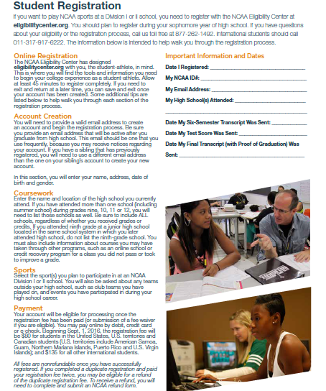

Slide 8
Step 2- Verify Eligibility
See your counselor to do an NCAA worksheet
Be sure you have enough core classes
(16 for Div I and Div II)
Calculate GPA on core courses
(2.3 minimum for Div I and 2.0 minimum for Div II)
Check SAT test scores
(Div I- sliding scale, Div II- sliding scale)

Slide 9
Step 3- Be a Qualifier
1) Graduate from Pomona- the NCAA will not accept you without graduating
2) Meet your core course requirements
3) Earn minimum GPA and SAT scores
(SAT test can be taken as many times as you want. They will use the highest subscore from any test to meet the minimum requirement.)

Slide 10
Core Course Requirements DI
Complete a total of 16 NCAA core courses in the
following areas:
4 years of English.
+ 3 years of math (Algebra 1 or higher).
+ 2 years of natural/physical science (including one
year of lab science if offered).
+ 2 years of social science.
+ 1 additional year of English, math or natural/physical science.
+ 4 additional years of English, math, natural/physical
science, social science, foreign language,
comparative religion or philosophy.

Slide 11
Core Course Requirements DII
Complete a total 16 core courses in the following areas:
3 years of English.
+ 2 years of math (Algebra 1 or higher).
+ 2 years of natural/physical science (including one
year of lab science if offered).
+ 2 years of social science.
+ 3 additional years of English, math or natural/
physical science.
+ 4 additional years of English, math, natural/
physical science, social science, foreign language

Slide 12
Pomona Approved Courses
English- all regular, Honors, and AP Courses, Plus ENGLISH ELECTIVES
Math- All levels of math including the Integrated Math classes
Science- all science classes are considered lab classes
Social Studies- all regular, honors, and AP classes, including Psychology
All world language courses count as core classes
Electives do not count as ncaa core classes

Slide 13
Div I Timeline for Core Courses
Core course information
Only courses completed in the eight semesters of grades 9-12 will qualify as core courses for Division I.
Courses taken in 8th grade will not count, even if they are high school-level courses.
In the event a student does not complete all 16 core courses during the eight semester time-frame, he/she can take one course to count towards the 16 course total.
Student MUST graduate on time with his/her class
The one extra course MUST be completed within the summer or the following academic year.

Slide 14
Div II Timeline for Core Courses
At DII Institutions, a student is permitted to use all core courses completed subsequent to the start of the ninth grade and prior to initial full-time enrollment at a collegiate institution.

Slide 15
Div I GPA and Test Score Sliding Scale
Core course GPA of 2.3 minimum
At 2.3 GPA, an ACT total score of 75 or SAT of 900 required
On the scale, as GPA goes up, the test score required goes down

Slide 16
Div II GPA and Test Score Sliding Scale
After August 1st 2018:
- core course GPA of 2.2 minimum
- at 2.2 GPA, an ACT total score of 70 or an SAT of 840
- on the scale, as GPA goes up, the test score required goes down

Slide 17
Partial Qualifier Status
Div I- Academic Redshirt
- Graduate, complete 16 core courses, and earn ACT or SAT combined score matching a minimum 2.0 GPA on the Div I sliding scale used for students enrolling after August 1st 2016
- May receive an athletic scholarship and may practice but may not compete during your first year
Div II- Partial Qualifier
- After August 2018, graduate, complete 16 core courses, and earn ACT or SAT combined score matching a minimum 2.0 GPA on the Div II partial qualifier sliding scale
- May receive an athletic scholarship and may practice but may not compete during your first year

Slide 18
Step 4- Send Records
Set up your NCAA account, recommended during your junior year
You will order 2 transcripts from Ms. Peterson in the counseling office- 1 will be sent after junior year, the other after graduation.
Order SAT test results. THESE MUST BE SENT DIRECTLY FROM THE COLLEGE BOARD. THE NCAA WILL NOT ACCEPT THE SCORES ON THE SCHOOL TRANSCRIPT).
www.actstudent.org or www.collegeboard.com

Slide 19
Additional Info
www.eligibilitycenter.org
Stay in touch with your counselor
Go to the Pomona website under the Counseling tab to download a copy of the 2017-18 Guide for College Bound Athlete
Nontraditional and Online Courses- see the guide and speak to your counselor to see if a course or school is NCAA approved
One-Time Fee Domestic = $80.00
(Fee waivers might be possible- see your counselor)

Slide 20
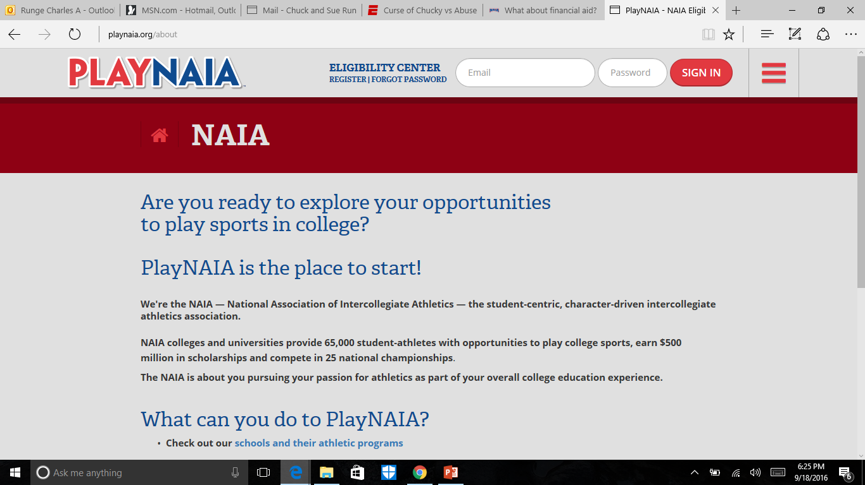

Slide 21
NAIA
Johnson and Wales University in Denver competes in NAIA in the Association of Independent Institutions
Kansas has a great 12 member league competing in NAIA

Slide 22
NAIA Eligibility
Financial Aid
NAIA rules on financial aid are straightforward. Each school determines how much aid it awards to an individual student-athlete. Under no conditions may anyone else provide direct financial assistance to any student-athlete. Scholarships, grants-in-aid or student loans are controlled by each institution through the same committee that handles all student loans and scholarships.
Financial aid to student-athletes is limited to the actual cost of: • Tuition • Mandatory fees, books and supplies required for courses in which the student-athlete is enrolled • Room and board based on the official room and board allowance listed in the institution's catalog
NAIA LIMITS ON FINANCIAL AID Each sport has an overall limit on the amount of financial aid it can award as full or partial grants to students in that sport. For example, the overall limit in baseball is 12. Baseball scholarships can be awarded to any number of students (for example, 1 full scholarship, 10 half awards and 24 quarter awards) as long as the combined total does not exceed 12. Limits on the total amount of aid that can be given to varsity athletes in each sport:

Slide 23
NJCAA Eligibility
Must be a high school graduate
Eligibility is determined by the entrance and enrollment requirements of the college
Aid is determined by the institution with a maximum of tuition, fees, room, board, and books
In Colorado:
- Colorado Northwestern CC
- Lamar CC
- Northeastern JC
- Otero JC
- Trinidad JC
California Community College Athletic Association

Slide 24
Contact your Counselor
Dan Borkovec- A-Fe Daniel.Borkovec@jeffco.k12.co.us 303-982-0695
Sandy Austin- Ff-L Sandy.Austin2@jeffco.k12.co.us 303-982-9402
Bonnie McCarty- M-Rn Bonnie.Mccarty@jeffco.k12.co.us 303-982-6432
Chuck Runge- Ro-Z Chuck.Runge@jeffco.k12.co.us 303-982-0696
Autumn Coppejans- 9th grade

